Slide 1
City Bike Data Analysis Using IBM Cloud Cogno's Dashboard

Slide 2
Team : CSE - 20
Sowmya - 19R11A05J9
Varun - 19R11A05K0
Mythili - 19R11A05K1
Nandini - 19R11A05K2
Madhuri - 20R15A0521

Slide 3
The goal of this analysis is to create an operating report of City Bike for the year 2015. OBJECTIVES OF THE PROJECT:
To create data visualizations to
Find the total number of trips
Find count of Customer and subscriber with gender
Find the top bike used with respect to trip duration
Calculate the number of bikes used by respective age groups.

Slide 4
Find top 10 Start Station Names with respect to Customer age group
Find top 10 start stations by total number of starts
Find the most popular trips
Calculate average trip duration by age and gender
Locate start stations with respect to trip duration and user type.

Slide 5
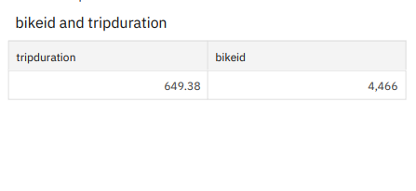
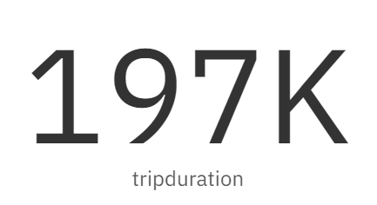
Number of Trips
To find the total number of trips , a table visualization is chosen with the bike id and trip duration fields.
The visualization is as follows:

Slide 6
Customer And Subscriber Count with Gender
To represent the customer and subscriber count with gender , a column graph is chosen.
The column user type consists of subscribers and customers categories taken on x-axis. The trip duration is taken on y-axis.
The visualization to show the count of customer and subscriber based on gender is as follows:

Slide 7
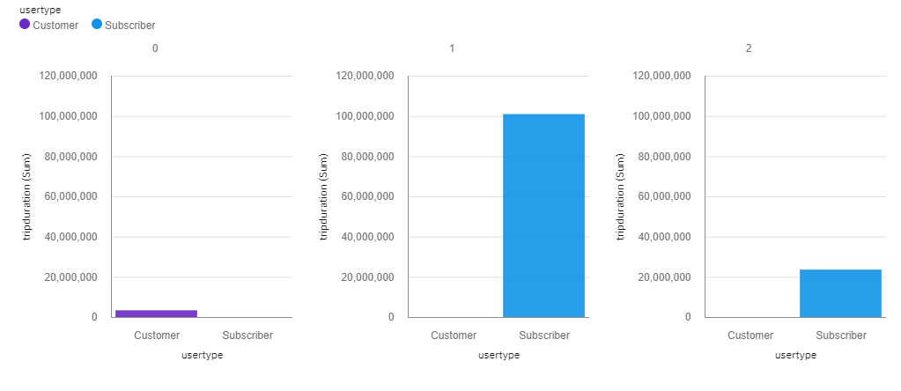

Slide 8
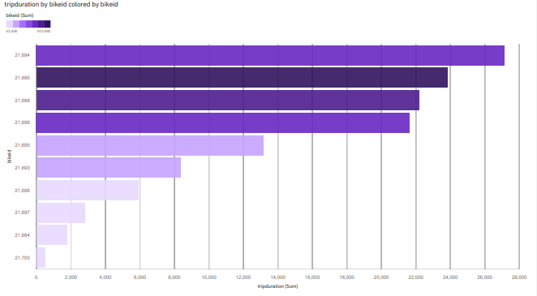
Top Bike Usage
For this visualization, a horizontal bar chart is used consisting of bike id and trip durations.

Slide 9
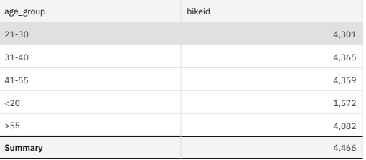
Age Group Differentiation By Bike
The age of the person is calculated by subtracting the birth year from the current year to make visuals easier to interpret.
A text table is used to differentiate the age groups based on bike id of the users.

Slide 10
Top 10 Start Station Names With Respect To Customer Age Group
A bar chart is used to plot the customer age group and trip duration to find the top 10 start station names.
The age group is collected from the previous analyses.
The resultant visualization is as follows:

Slide 11
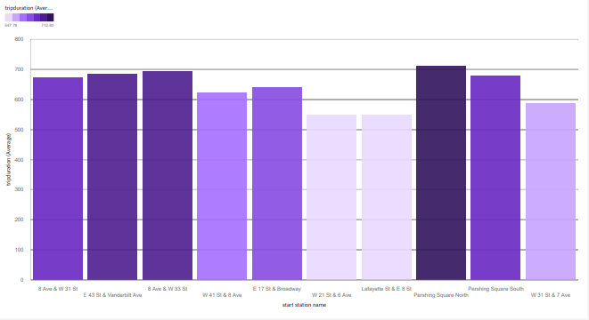

Slide 12
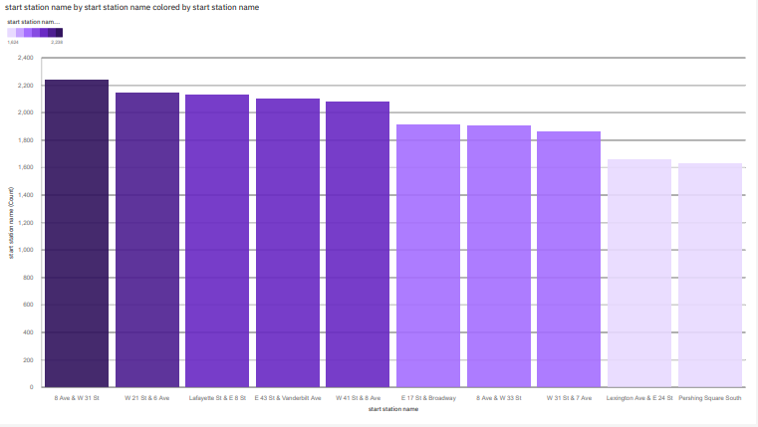
Top 10 Start Station Names By Number Of Starts
A bar chart is used to plot the start station names with respect to the specific count of number of starts at that particular station.

Slide 13
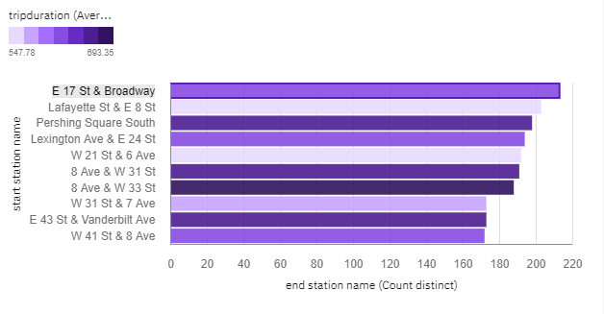
Most Popular Trips
To create this visualization a horizontal bar chart is used by plotting start station and the distinct count of trips at end station.

Slide 14
Average Trip Duration By Age & Gender
To calculate the average trip duration by age and gender , a column graph and a line graph are used.
The fields trip duration and the gender are plotted on the column graph.
Average age is taken as a line and is plotted accordingly to the column graph.
The resultant visualization is as follows:

Slide 15
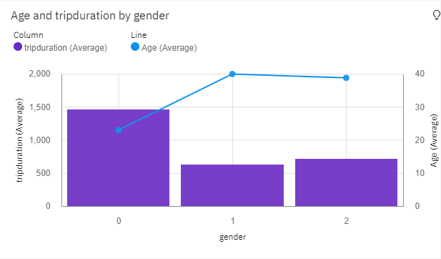

Slide 16
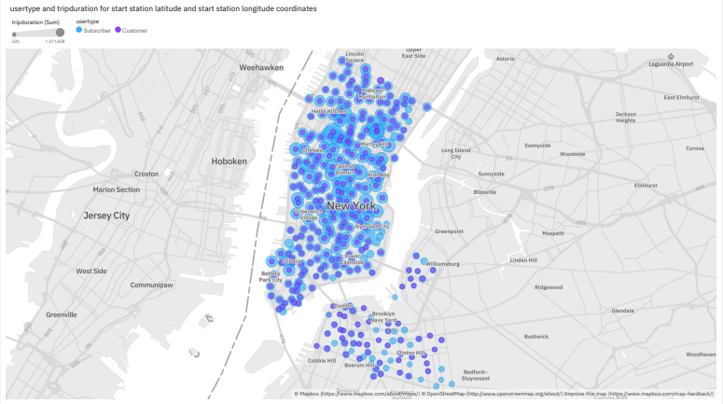
Locating Start Stations with Trip Duration and User Type
A map visualization is used to plot the start stations with respect to trip duration and user type.

Slide 17
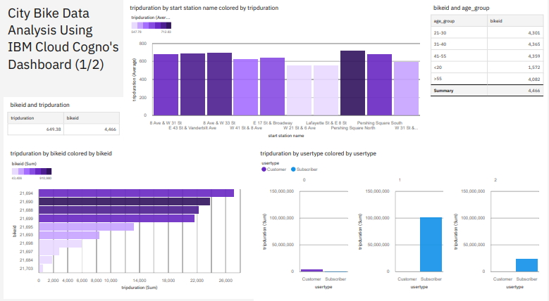
FINAL DASHBOARD
The final dashboard is the compilation of all the visualizations used.

Slide 18
